Slide 1
Regular expression and class
Python Lecture 4

Slide 2
Learning Objectives
By the end of the lesson, you will learn:
What is regular expression.
Usages of regular expression in Python for
matching
searching
substitution

Slide 3
Regular Expression
It is a powerful tools to enable you to find, extract and modify text that matches predefined patterns.
Available in most of the programming language (build-in or library based)

Slide 4
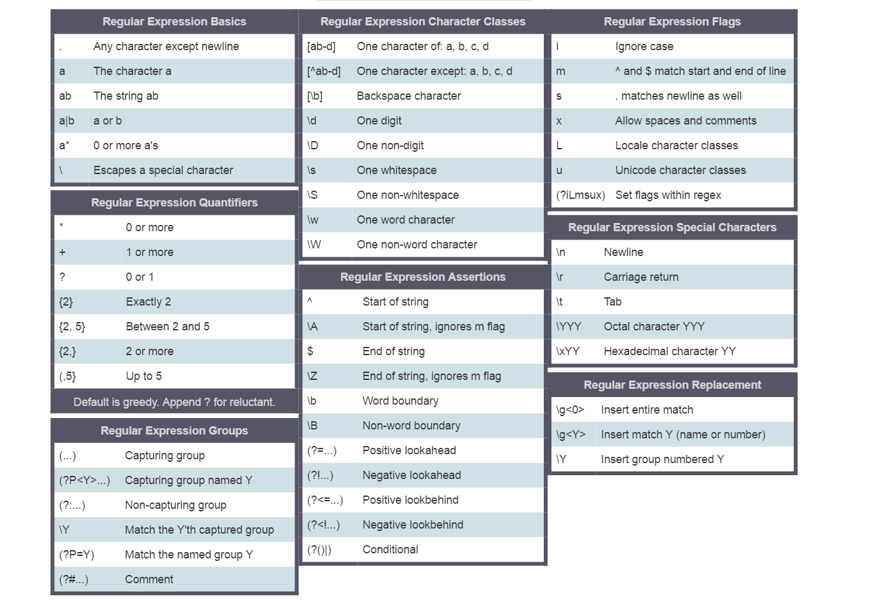
Metacharacters
Regular Expressions are powerful
They are made up with metacharacters
E.g.
“.” used to symbolize a single character
[xyz] used to symbolize matching of a single character with either x or y or z
\d used to symbolize a digit
[0-9] same as \d
[0-9]{0,3} used to symbolize matching of 0, 1 or up to 3 digit(s)
Refers to the recommended reading page for the URL of the Python Regular Expression Cheat sheet

Slide 5
Python regular expression primitive search functions
re.match(pattern, string)
Try to match the pattern from the string
The pattern can be a normal string or a regular expression (made up of meta-characters)
Returns a match object on success, None on failure
checks for a match only at the beginning of the string
re.search(pattern, string)
Returns a match object on success, None on failure
checks for a match anywhere in the string

Slide 6
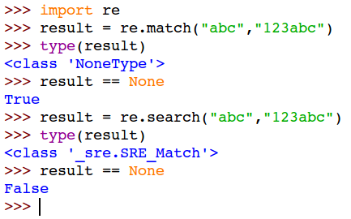
Python regex basic find functions
re.match(pattern, string)
re.search(pattern, string)
Example 0:
Match/search for the pattern of "abc" (no regex involves) from string.

Slide 7
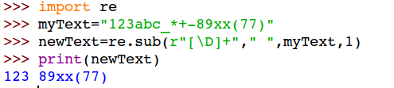
Python regex basic find and replace function
re.sub(pattern,repl,string,count=0,flags=0)
Example 1:
Replacing the first occurrence of a sequence of non-digit characters with a single ' ' s
[\D]+ → denotes a sequence of non-digits
r"" → insert a leading 'r' to denote a 'raw string literal'.

Slide 8
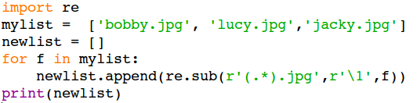
'Repl' can also be a regex pattern
Example 2:
Truncate the .jpg suffix from a list of jpeg filenames.

Slide 9
Use cases of regular expressions
Information Extraction
Search and pickup specific entries from a network traffic log file
Counting the total number of 404 (page not found)
Massive text formatting and cleansing
Input validation
For instance
Before converting a binary number into decimal, you may want to first check if the input string is containing only 0s or 1s.
See from the next few slides

Slide 10
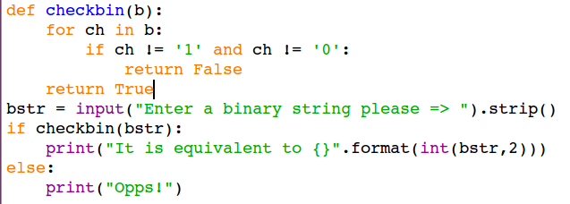
To validate a binary value input
Without Regular Expression
This is the conventional approach
Require character by character checking within a iteration block.

Slide 11
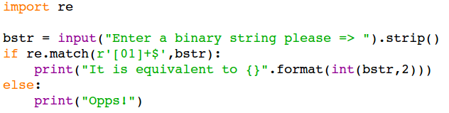
To validate a binary value input
With Regular Expression
With re module
Using match function
Using a regular expression 'pattern' to check against a given 'text'
re.match(search_pattern,target_string)
search pattern = r'[01]+$'
This bizarre looking pattern is in fact a
"regular expression"
r --> denotes the follow string is a regex pattern
match() starts at the beginning of the target string
'[01]+$' --> A pair of quotes encloses the pattern
[01] --> Matching with one character, it can be either a '0' or '1'
[01]+ --> The '+' denotes 1 or more repeating matches
$ --> The '$' denotes the end of the target string. d

